Slide 1
Capstone Project
Final Presentation
By Zero to Hero

Slide 2
About AUT - TravelApp
A travel and tourism management system.
Five modules: administrator module, travels module, routes module, reservations module and feedback module
Software:
Technology: Java and J2ee
Web Technologies: HTML, JavaScript, CSS
Web Server: Tomcat
Database: MySQL

Slide 3
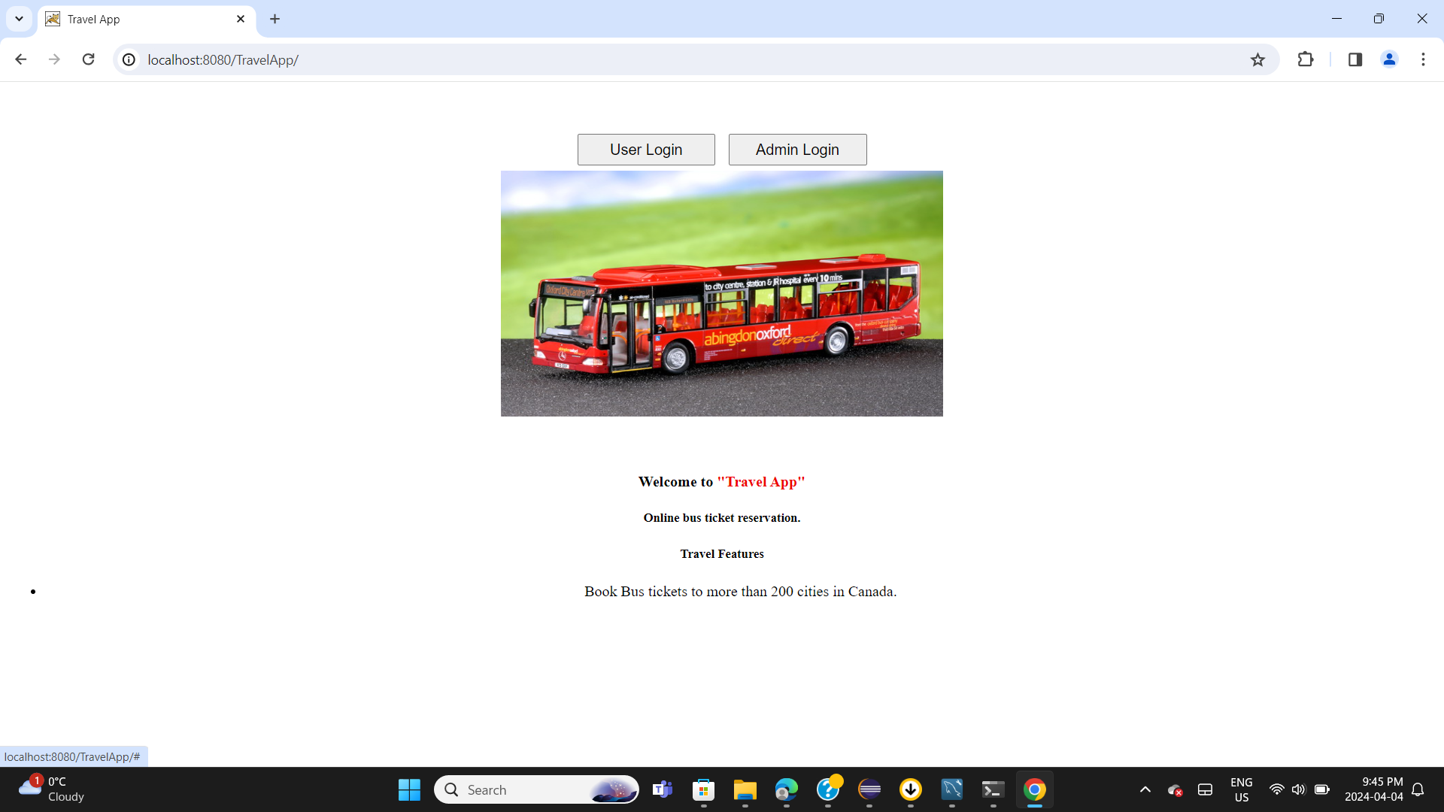

Slide 4
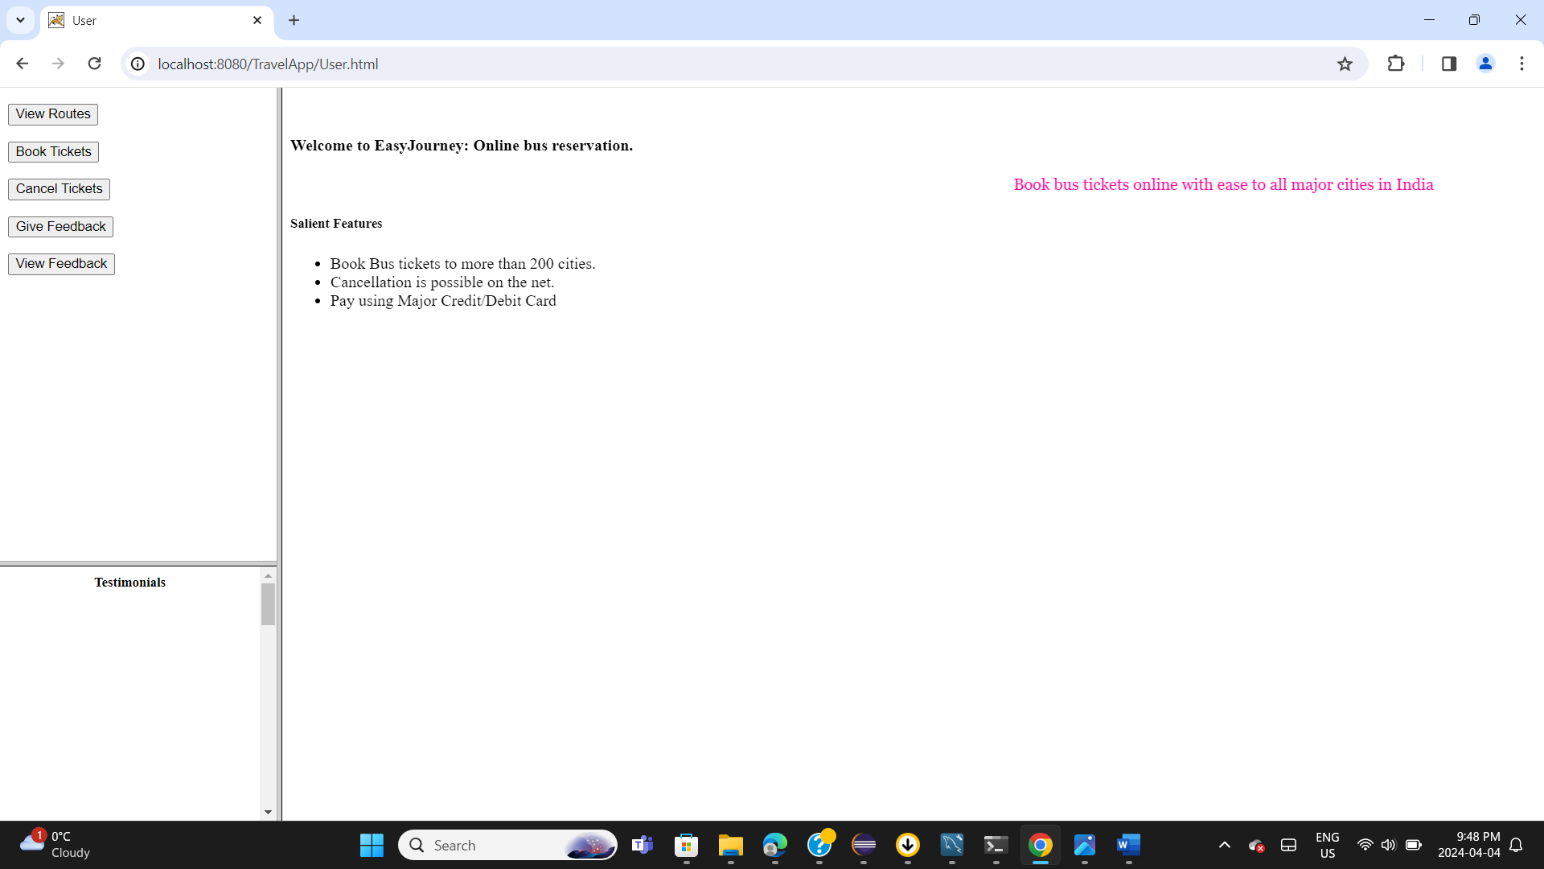

Slide 5
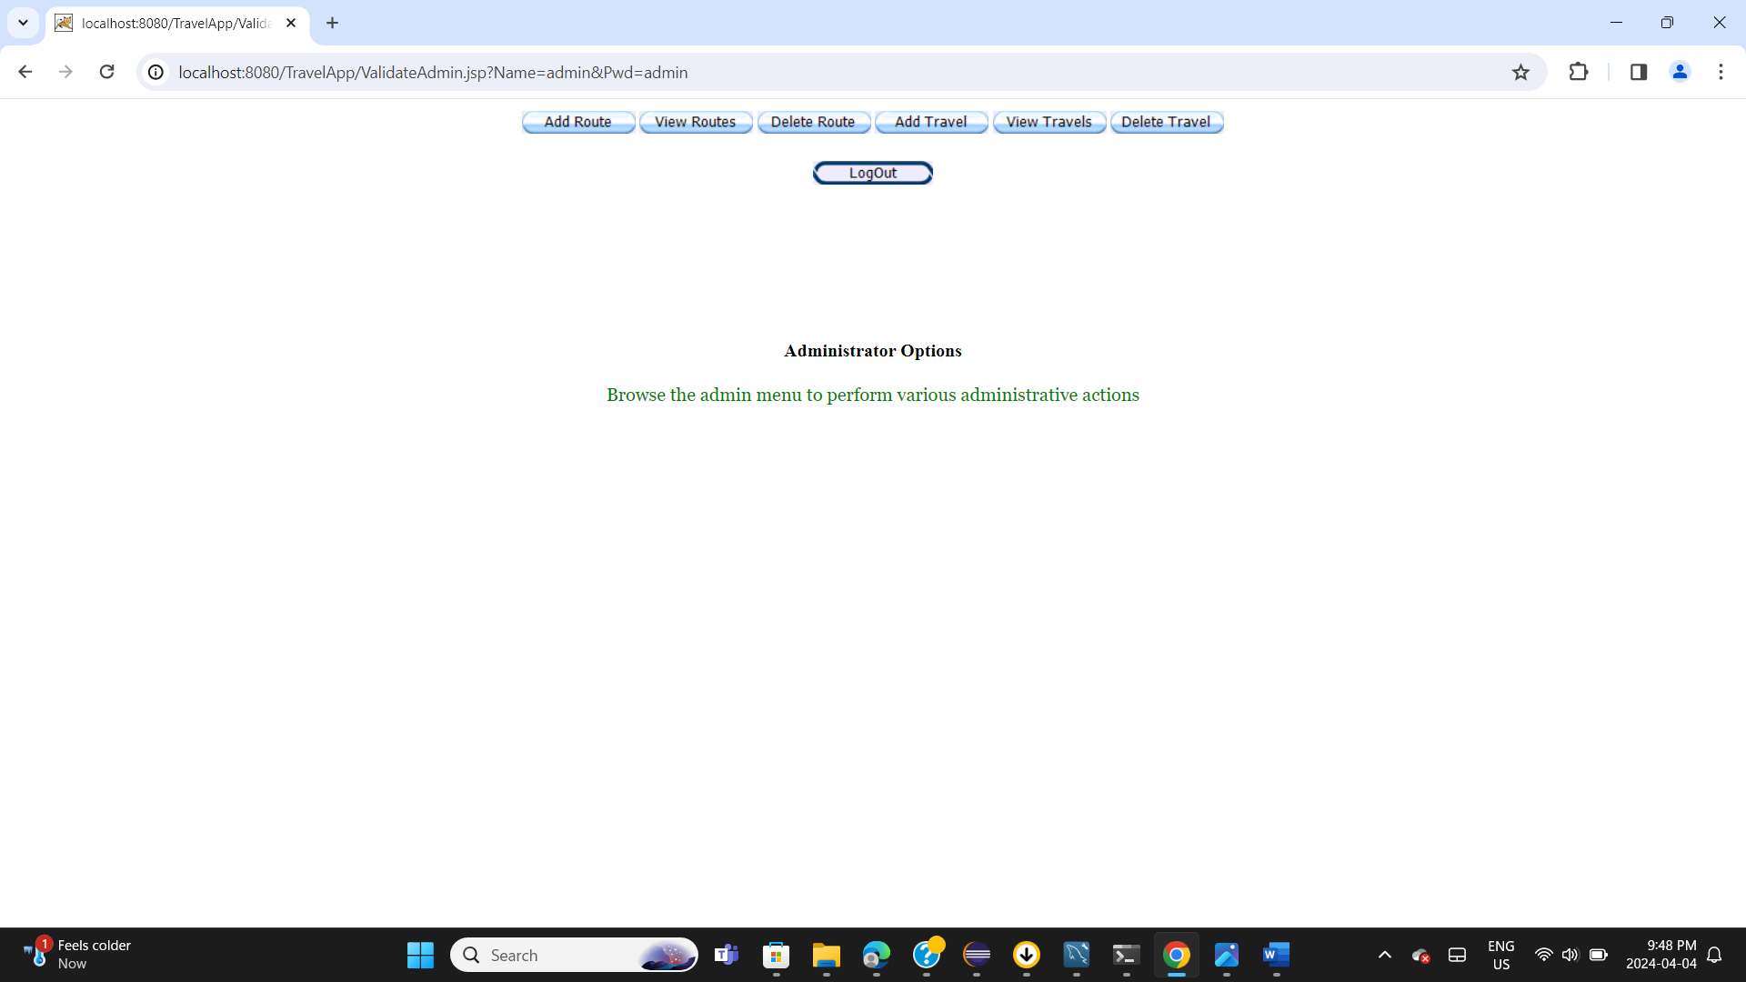

Slide 6
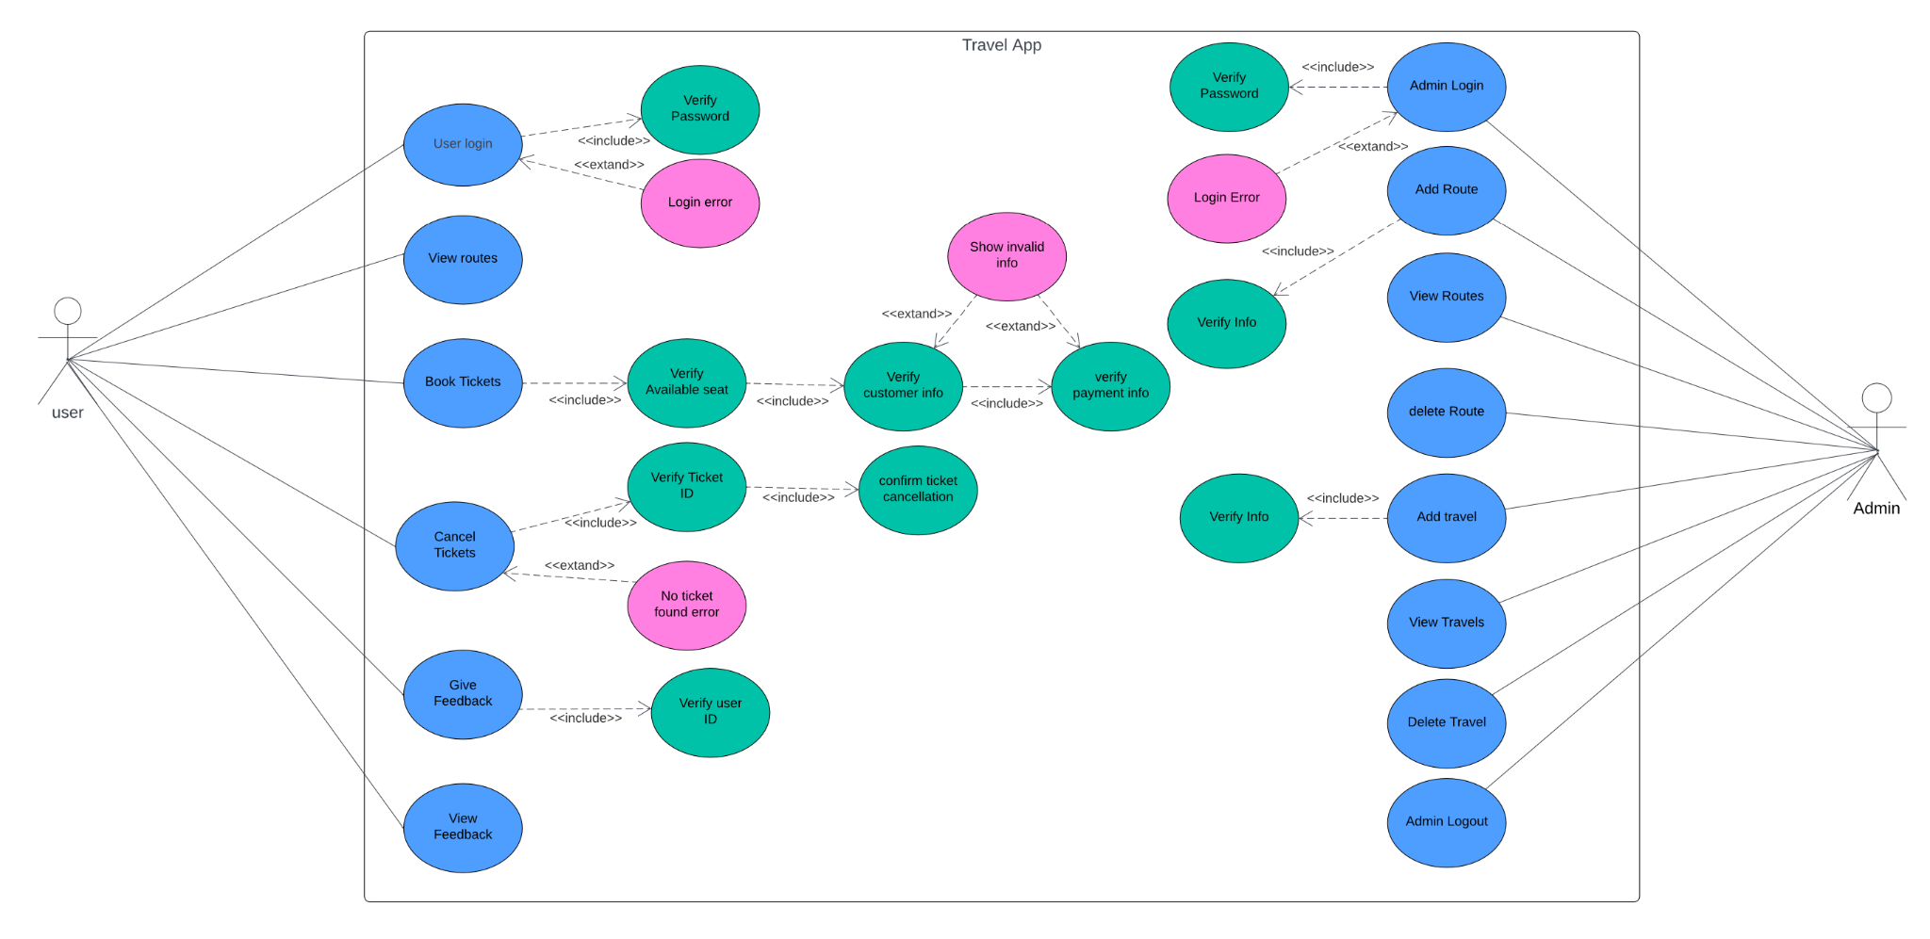
Use Case Diagram

Slide 7
Types of testing done
Our team Zero to Hero performed Functional and Non-Functional types of testing on the Travel app application.
Functional Testing: Functional testing is conducted to verify the overall functionality of the Travel app.
1. Integration testing:
2. System testing:
Non-functional testing:- Non-functional testing is conducted to check the overall performance of the Travel app.
1. Performance testing:
2. Load testing:
3. Usability testing:
4. Compatibility testing:

Slide 8
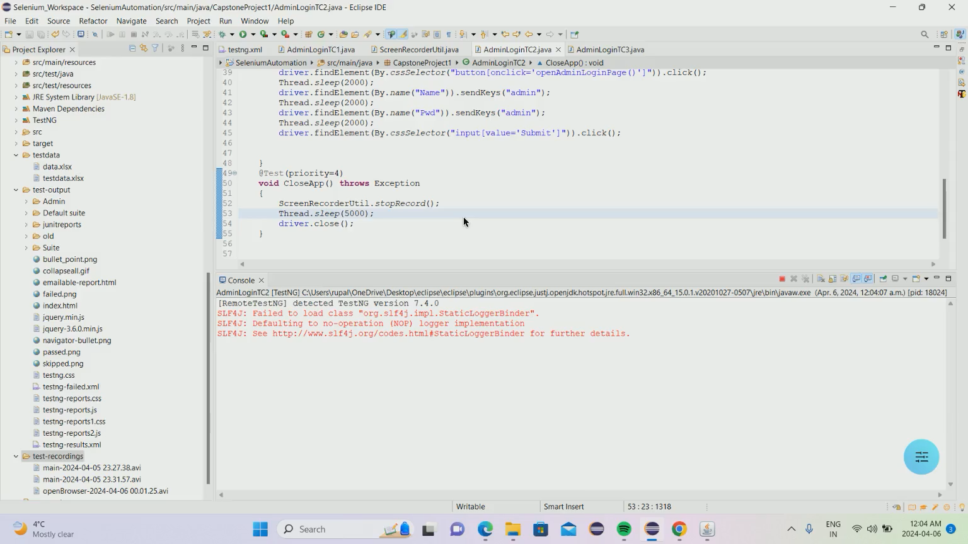
Functional Test cases (demo)

Slide 9
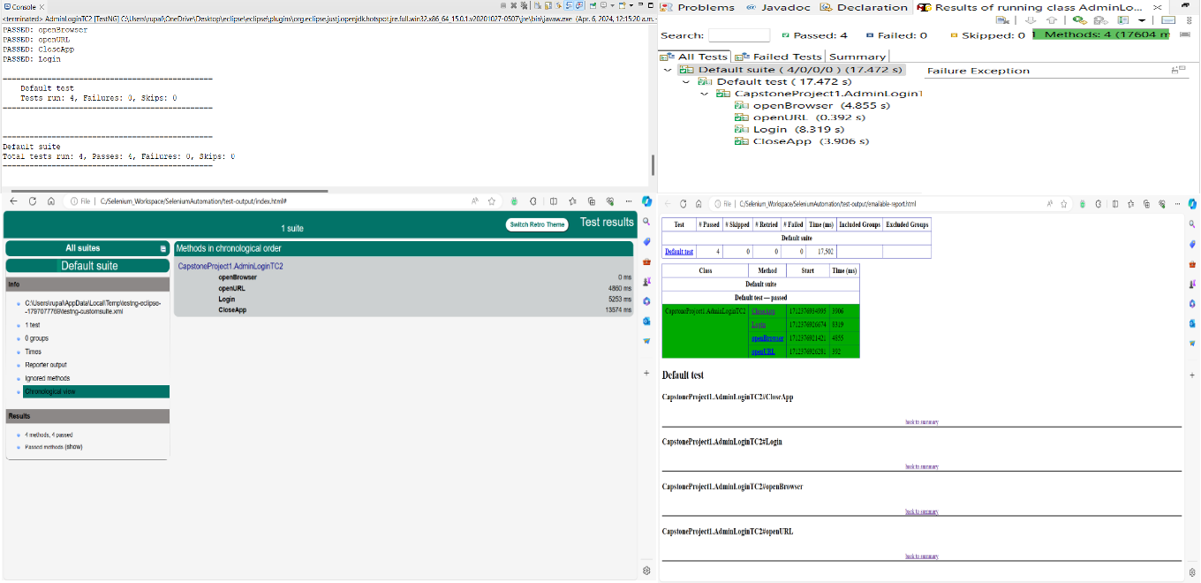
Functional Test cases (demo)

Slide 10
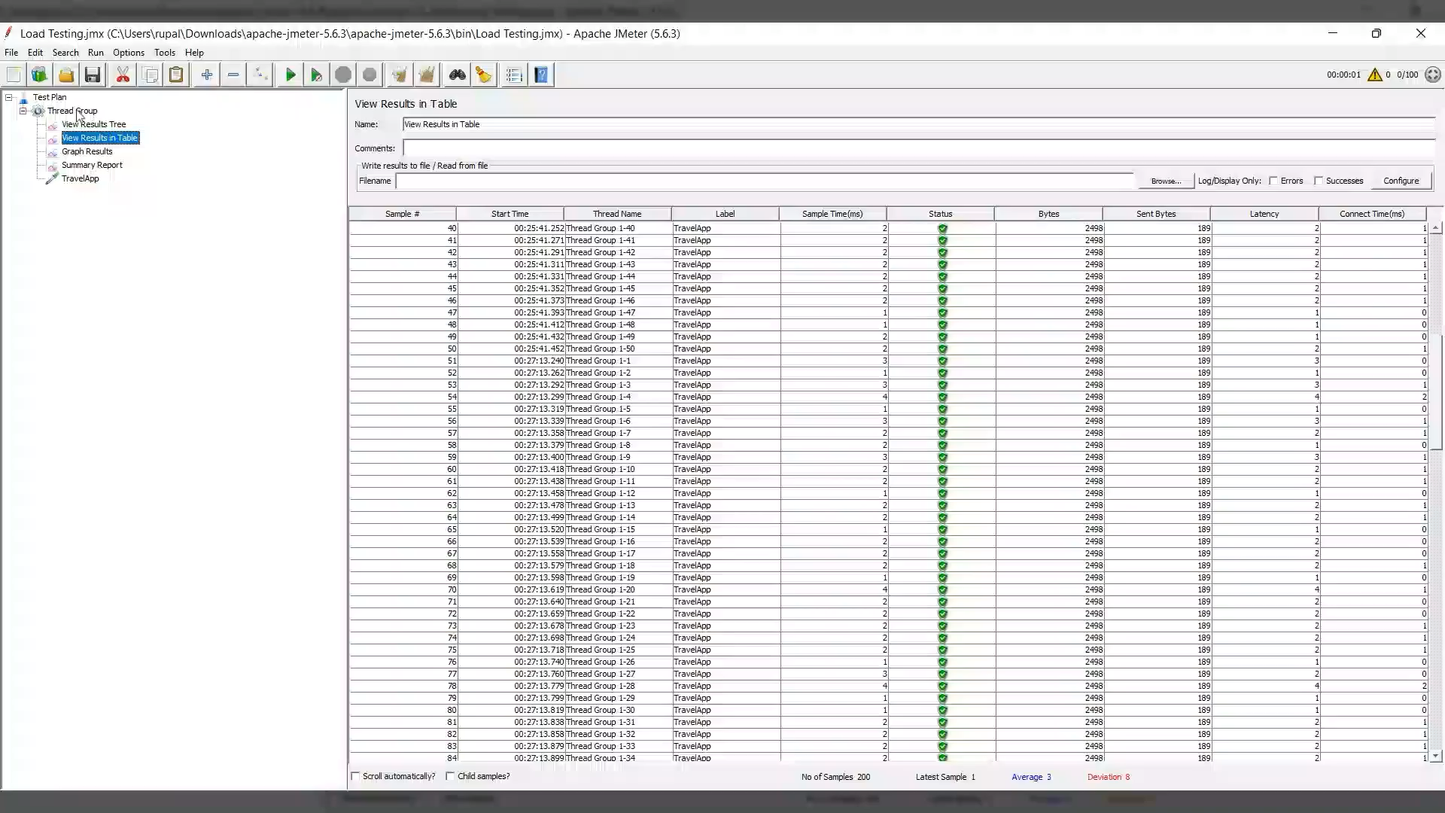
Non-Functional (demo)

Slide 11
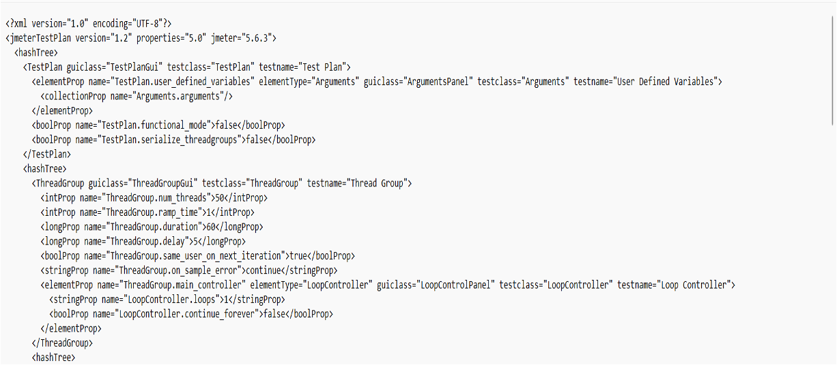
Non-Functional (demo)

Slide 12
Test management tools
Microsoft Office Suite
●MS Project – To create plan , manage team and track project and generate reports
●MS Word, MS Excel, MS Powerpoint – To create documents, analyzing test data and for prsentation.
Google Workspace
●Google doc, sheets ,slides - To work collaboratively and synchronously online as a team to create test documents, test sheets and presentation for project.

Slide 13
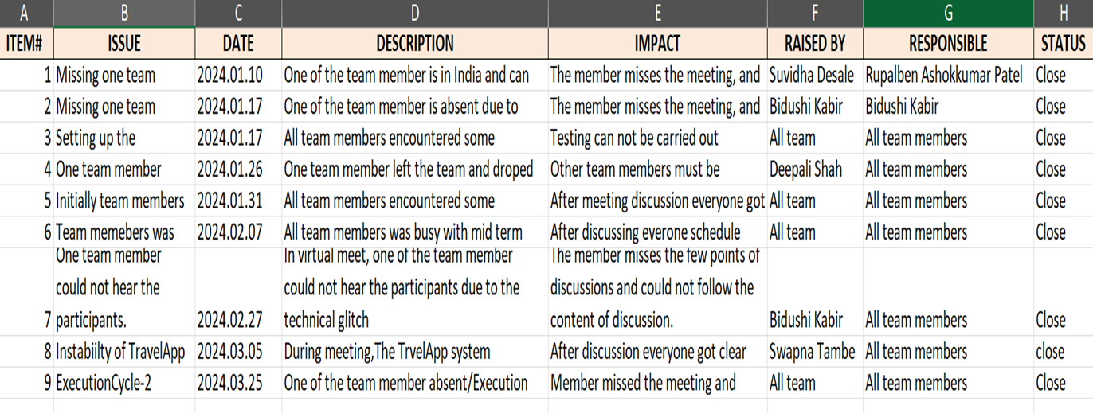
Test management tools
IAD logs - Issues

Slide 14
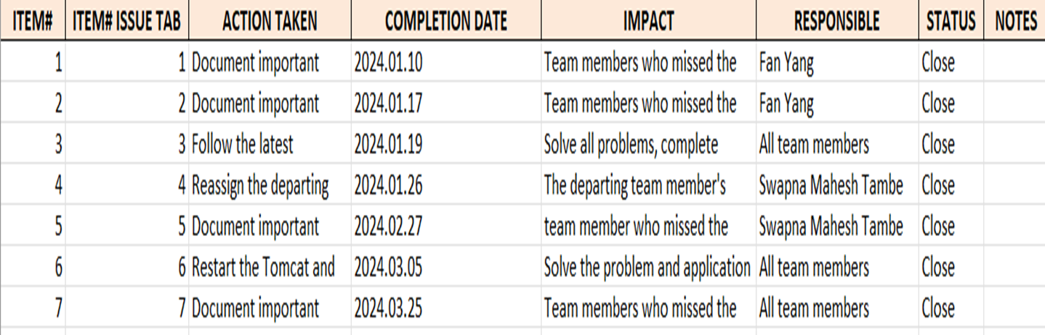
Test management tools
IAD logs – Actions

Slide 15
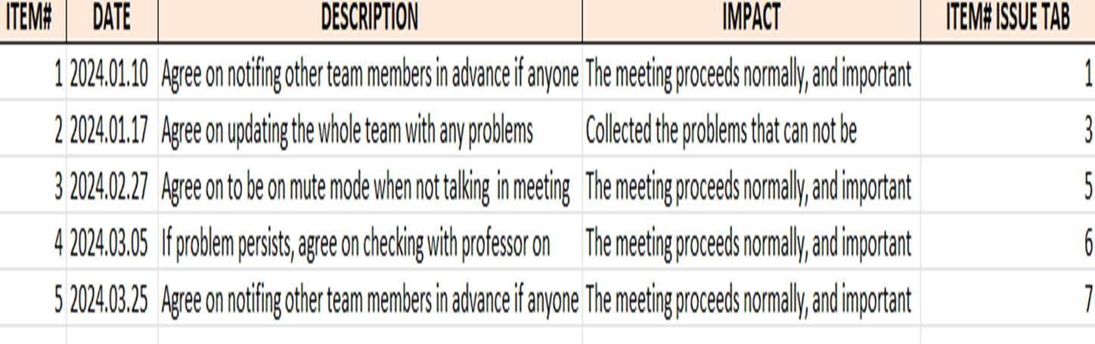
Test management tools
IAD logs -Decision

Slide 16
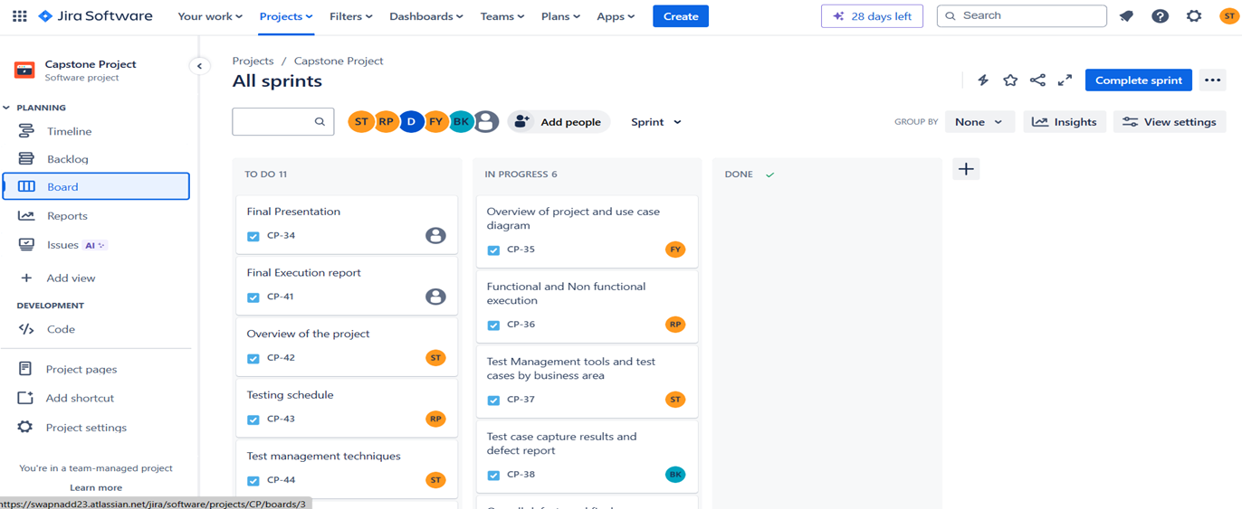
Test management tools
JIRA

Slide 17
Overall testing report by business areas
●An Overall testing report by business areas provides a summary of testing activities and its results for TravelApp Web application Project.
●It provides the insight into the test data and its results for its functional non functional areas of the project .

Slide 18
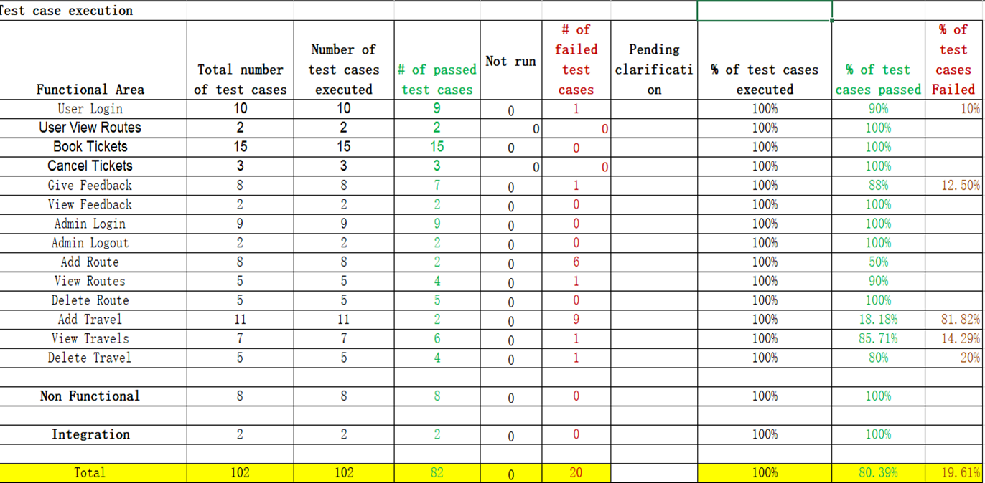
Overall testing report by business areas

Slide 19
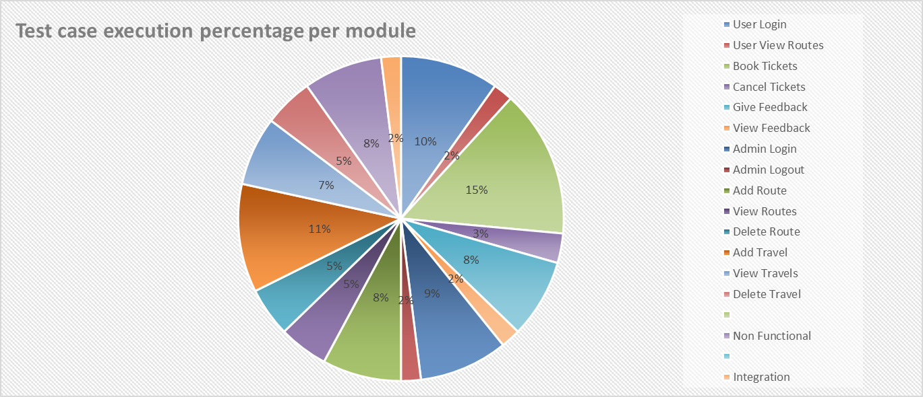
Overall testing report by business areas

Slide 20
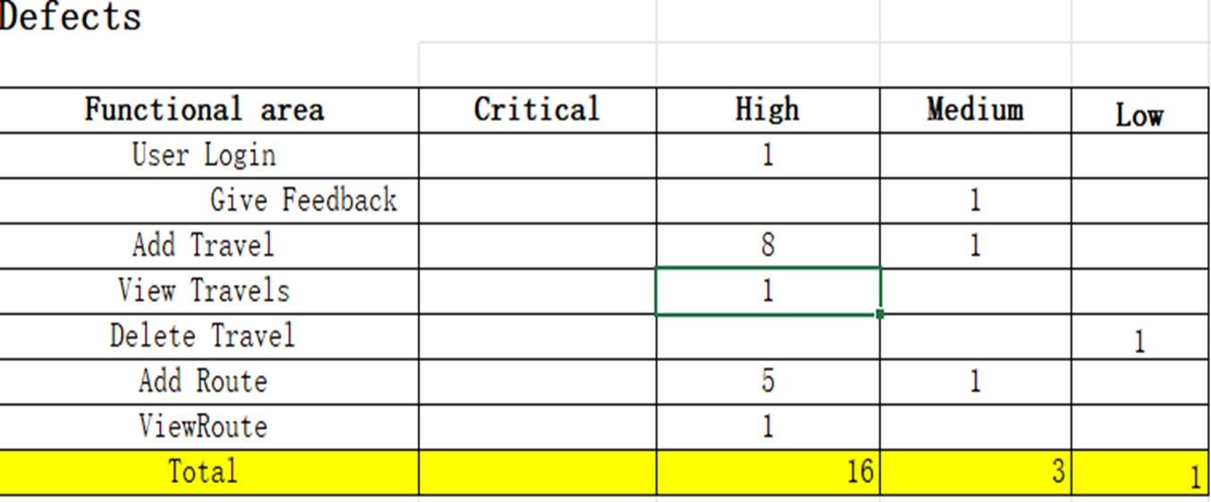
Overall testing report by business areas

Slide 21
Show examples of captured test results.
View routes pickup point verification

Slide 22
Walkthrough of a passing test
View routes pickup point verification

Slide 23
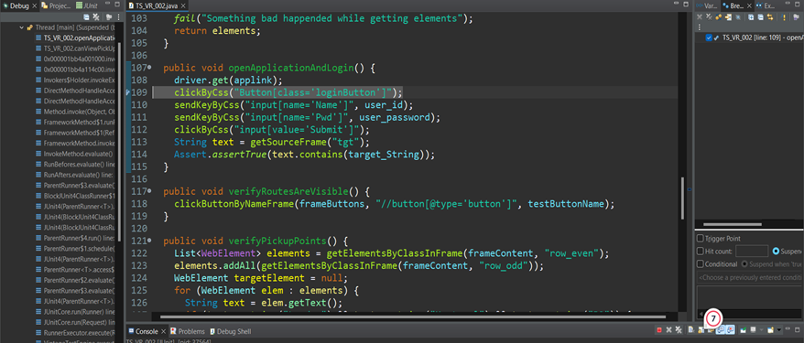
Code to open the application in the browser

Slide 24
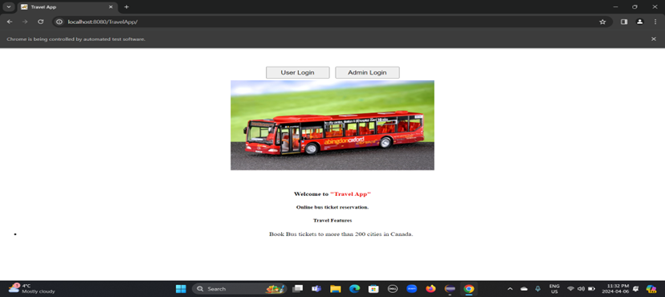
Travel App opened in web browser

Slide 25
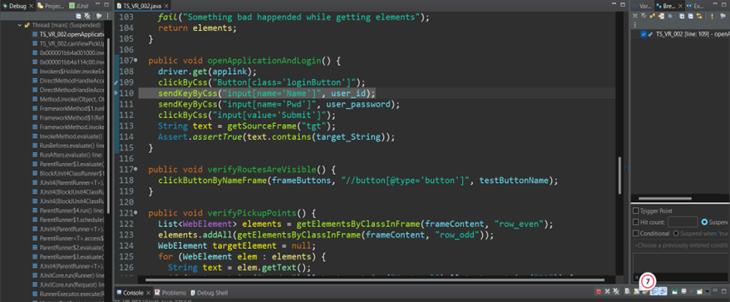
After clicking on user login button

Slide 26
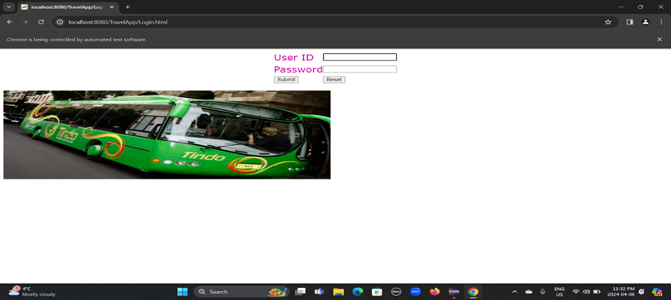
User login page opened in the browser

Slide 27
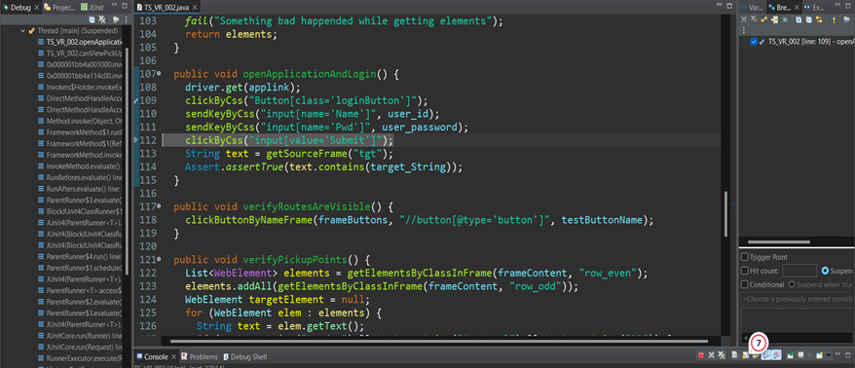
After filling the login information

Slide 28

After filling the login information

Slide 29

After clicking the submit button

Slide 30
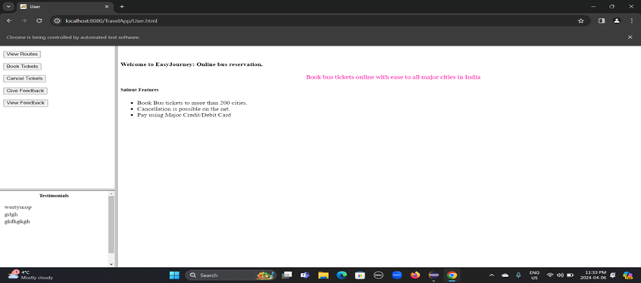
After clicking the submit button

Slide 31
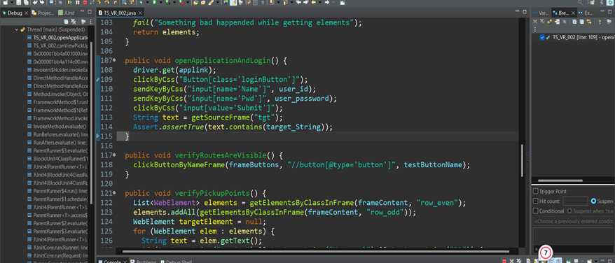
Verified user login successfully

Slide 32
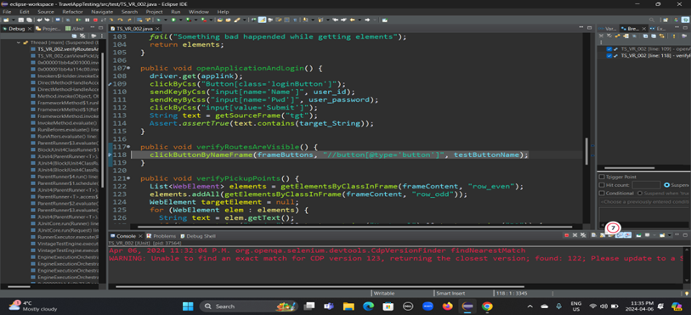
Next clicking on the ‘view routes 'button

Slide 33
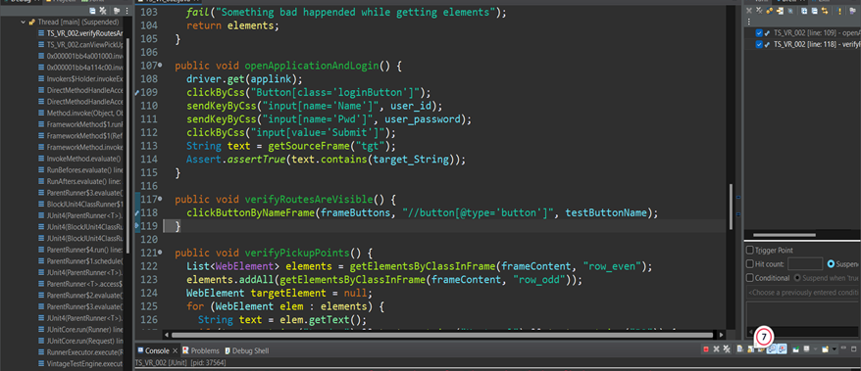
After clicking on the ‘view routes’ button

Slide 34
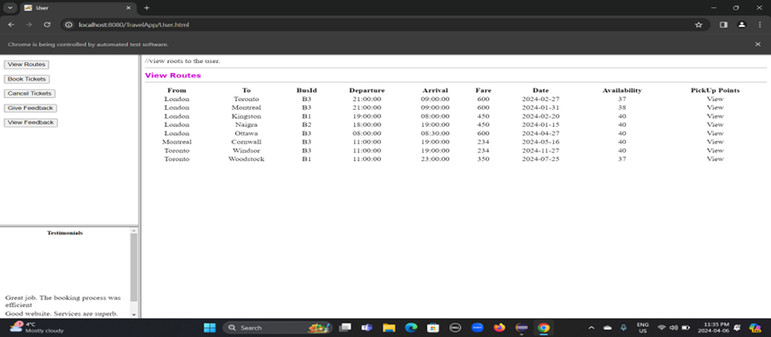
After clicking on the ‘view routes’ button

Slide 35
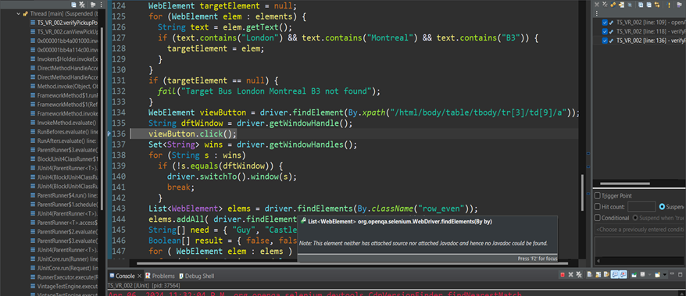
Before clicking the view pickup points button

Slide 36
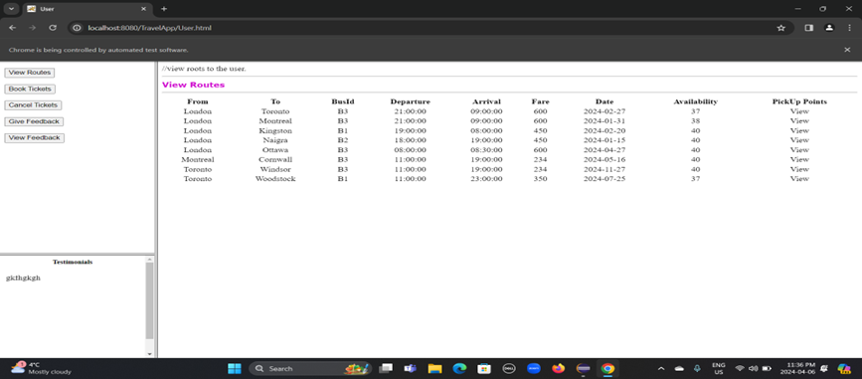
Before clicking the view pickup points button

Slide 37
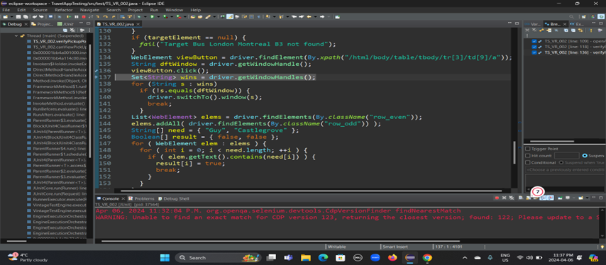
After clicking the view pickup points button

Slide 38
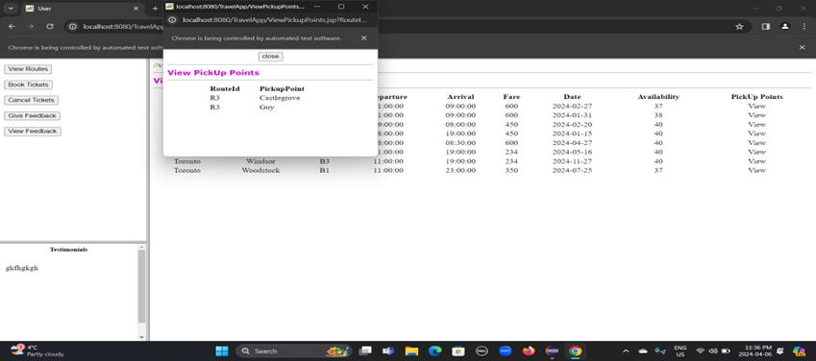
After clicking the ‘view pickup points ’ button

Slide 39
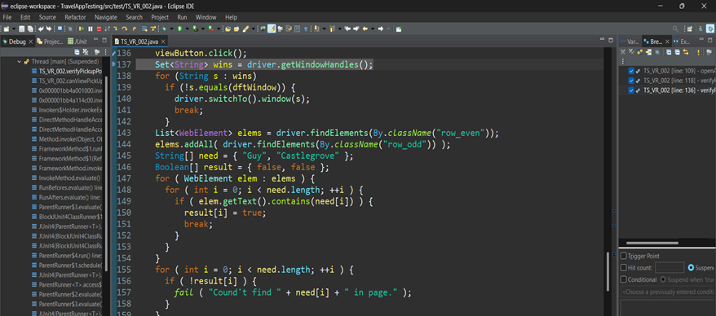
Switching to new window

Slide 40
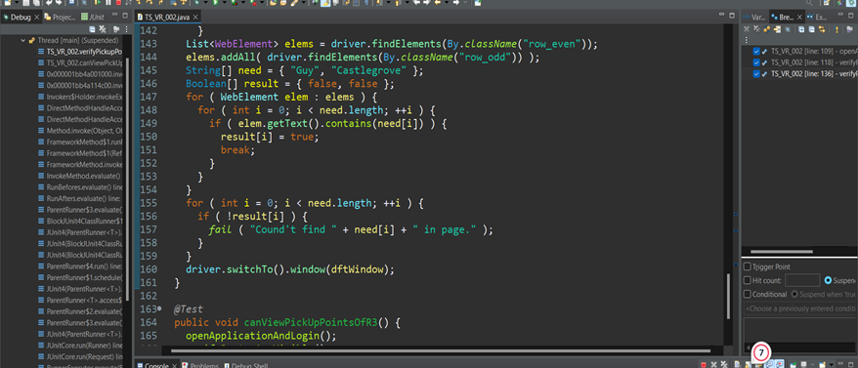
Collecting pickup points

Slide 41
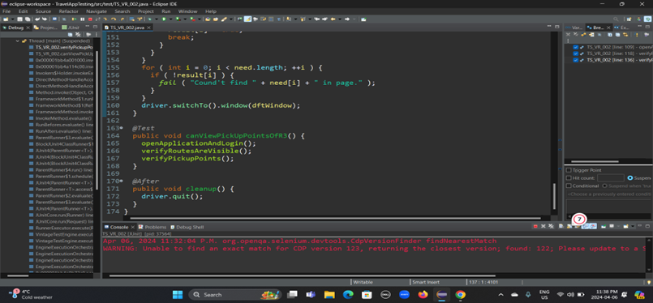
Verifying every pickup point are present

Slide 42
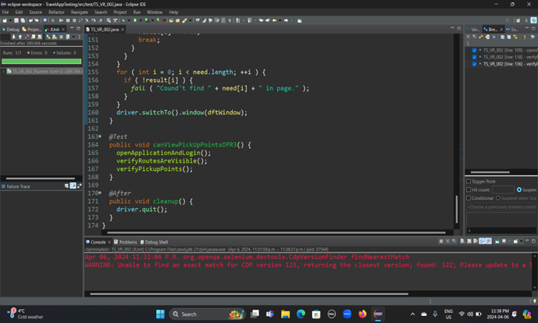
Finally, the execution result

Slide 43
Walkthrough of a failing test
User login with empty user ID

Slide 44
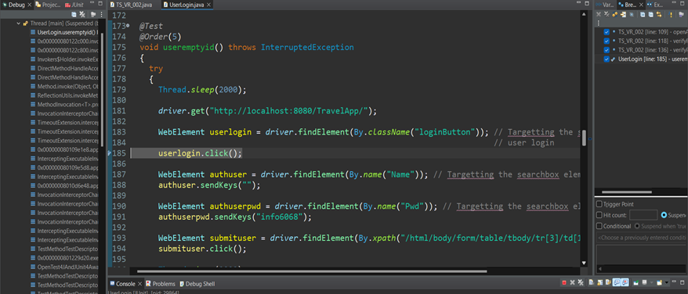
After opening Travel App

Slide 45
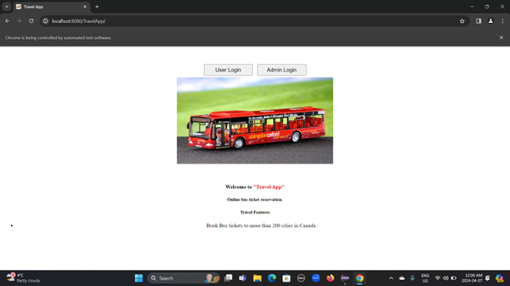
After opening Travel App

Slide 46
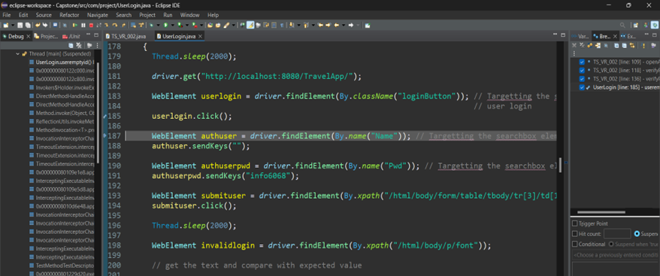
After clicking on user login button

Slide 47

After clicking on user login button

Slide 48
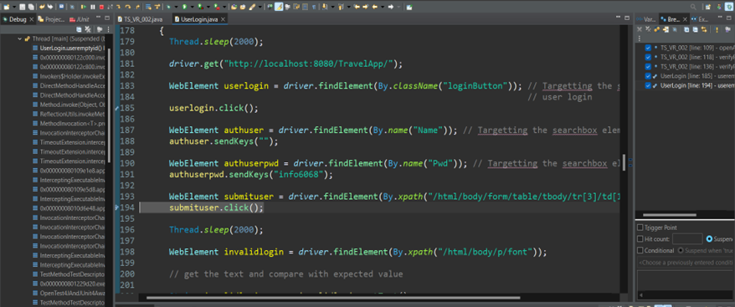
After filling the user login information

Slide 49

After filling the user login information

Slide 50
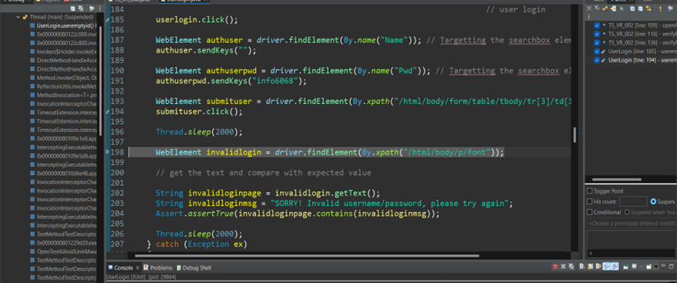
After clicking the submit button

Slide 51
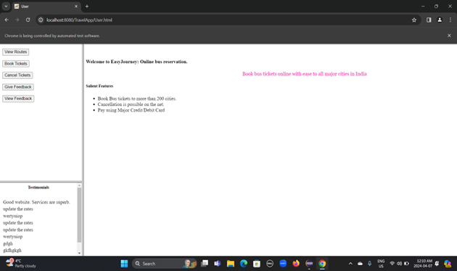
After clicking the submit button

Slide 52
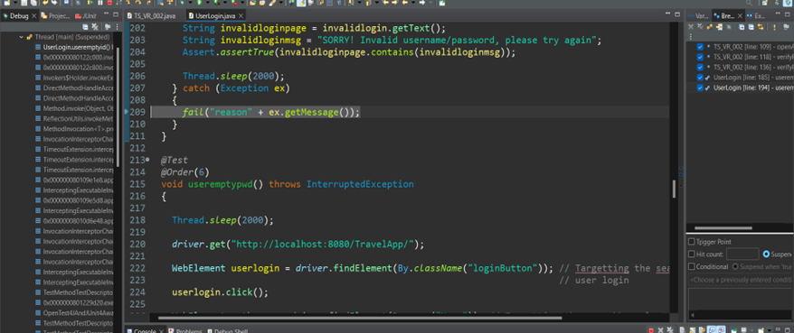
Something went wrong

Slide 53
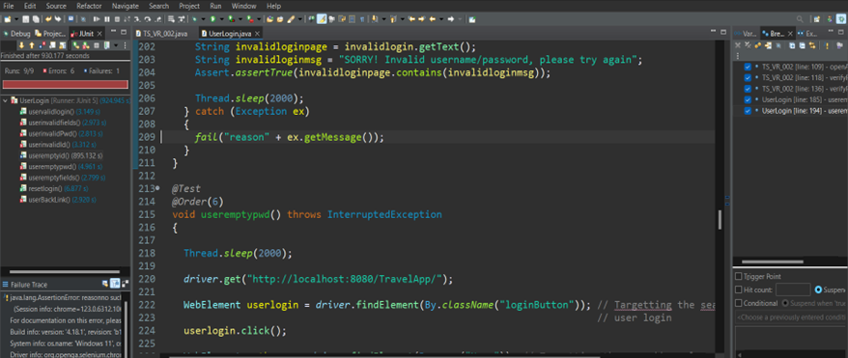
Finally, the execution result

Slide 54
An example of a defect report.
Back button broken on invalid login

Slide 55
Recreating a defect from a defect report
Back button broken on invalid login

Slide 56
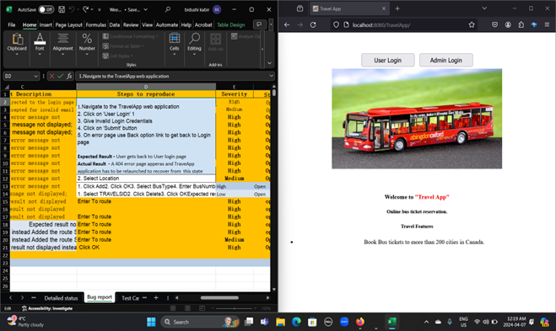
Defect reproduce step 1

Slide 57
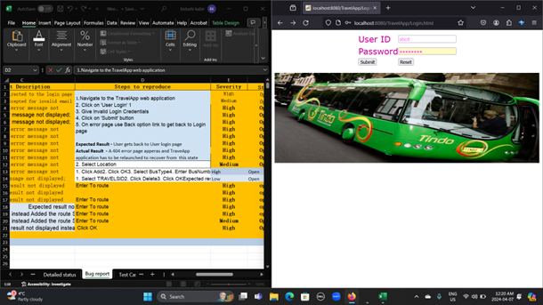
Defect reproduce step 2&3

Slide 58
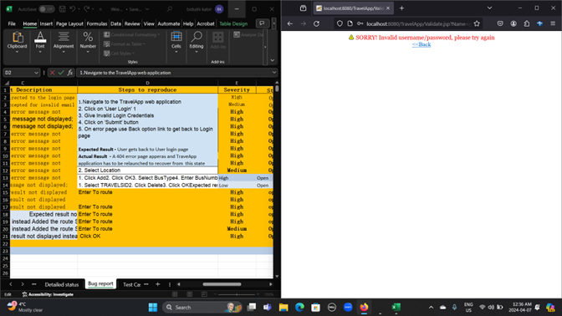
Defect reproduce step 4

Slide 59
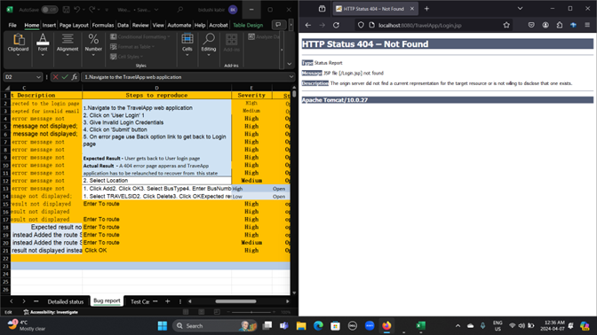
Defect reproduce step 5

Slide 60
Overall Defect Report
Overall Defect Report
Functional Area | Critical | High | Medium | Low
User Login |  | 1
Give Feedback |  |  | 1
Add Travel |  | 8 | 1
View Travel |  | 1
Delete Travel |  |  |  | 1
Add Route |  | 5 | 1
View Route |  | 1
Total |  | 16 | 3 | 1

Slide 61
Final recommendations & Lessons Learned
Since January, Travel Application testing is completed for difference module like administrative, travel etc. Travel application testing is completed using manually as well as automation scripts are developed and tested.
We covered almost 100% testing of travel application except non-functional. We do find some functional defects in different modules as follows…
Module Name | No. of Defects | Test Coverage
Use Login | 1 | 90%
Feedback Module | 1 | 88%
Add Route | 6 | 50%
Travel Add | 9 | 18%
Delete Travel | 1 | 85%
View Travel | 1 | 80%

Slide 62
Final Recommendation and Lesson learned
After completing the automation testing, we did not find any critical issues, only found High severity and medium severity defects. From the above test coverage, Statistics showed that we will improve the quality of the testing for some of the functional areas for the future project and also to maintain the test coverage we will choose the quality automation framework.
2. All the teammates work effectively on the project. We all had weekly meetings to discuss about the project and focused on issues. For the future project, we will have clear goals so we will not make mistakes and deliver the project on time.

Slide 63
Thank You

